Slide 1
Edge Detection
Ramidi Tarun Reddy
Mallepalli Rakesh Reddy

Slide 2
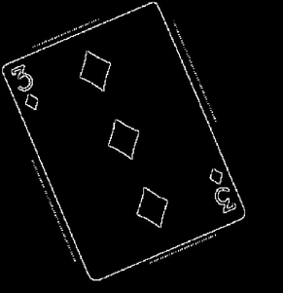
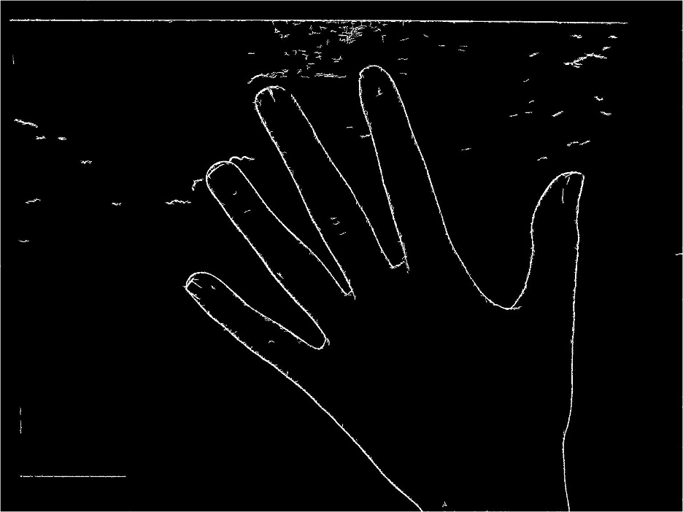
Edge detection is an image processing technique for finding the boundaries of objects within images. It works by detecting discontinuities in brightness.
Edge detection is used for image segmentation and data extraction in areas such as image processing, computer vision.

Slide 3
Canny Edge Detection
Smooth image with a Gaussian filter.
To eliminate the noise in the image.
Compute the Gradient magnitude using approximations of partial derivatives
Thin edges by applying non-maxima suppression to the gradient magnitude
Detect edges by double thresholding and Hysteresis.

Slide 4
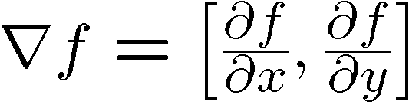
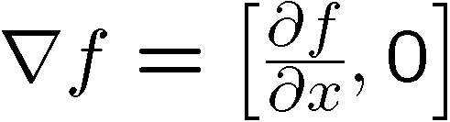

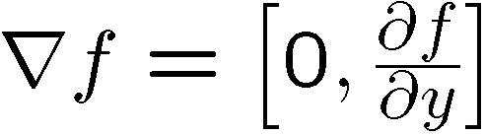
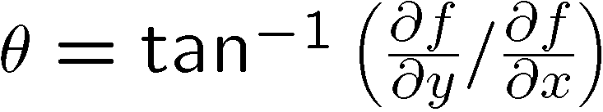
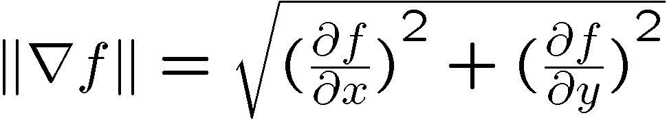
Image gradient
The gradient of an image:
The gradient points in the direction of most rapid change in intensity
The gradient direction is given by:
how does this relate to the direction of the edge?
The edge strength is given by the gradient magnitude

Slide 5
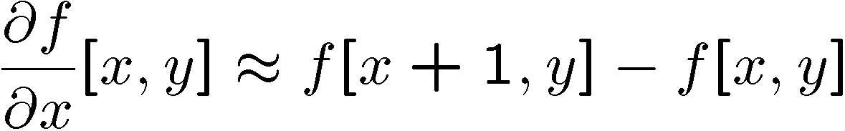
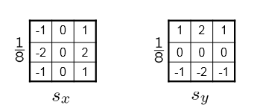
The discrete gradient & Sobel Operator.
How can we differentiate a digital image f[x,y]?
reconstruct a continuous image, then take gradient
Since, it is difficult to do so, we take discrete derivative (finite difference)
The Sobel operator is used to take approximate gradient functions in x and y directions

Slide 6
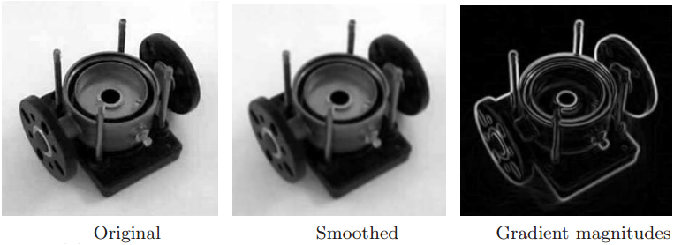
Non Maxima Suppression

Slide 7
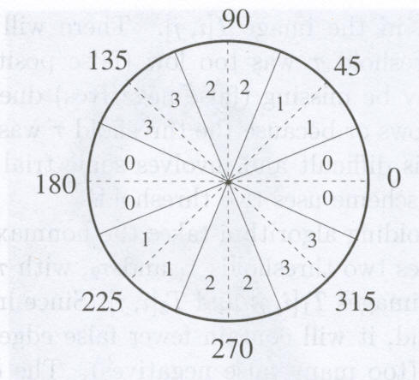
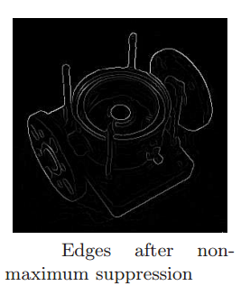
Reduce angle of Gradient θ[i,j] to one of the 4 sectors
If the value at the center is not greater than the 2 values along the gradient, then G[i,j] is set to 0

Slide 8
Double threshold & Hysteresis
Canny does use two thresholds (upper and lower):
If a pixel gradient is higher than the upper threshold, the pixel is accepted as an edge.
If a pixel gradient value is below the lower threshold, then it is rejected.
If the pixel gradient is between the two thresholds, then it will be accepted only if it is connected to a pixel that is above the upper threshold.

Slide 9
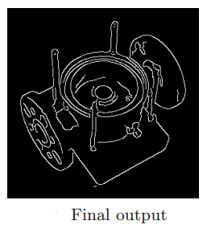
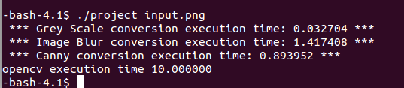
Final Result
Use of shared memory increases the performance.

Slide 10
References
http://www.cse.iitd.ernet.in/~pkalra/csl783/canny.pdf
http://docs.opencv.org/2.4/doc/tutorials/imgproc/imgtrans/canny_detector/canny_detector.html
http://www.umiacs.umd.edu/~ramani/pubs/luo_gpu_canny_fin_2008.pdf
http://www.cfar.umd.edu/~fer/cmsc426/lectures/edge1.ppt

